Slide 1


Online Payment Fraud Detection System

Slide 2

Group Members
Sandeep Kumar
Abhishek Pal

Slide 3
Introduction
Built a machine learning model to find fake online transactions.
Used a dataset with different features of transactions.
Used Random Forest to make predictions.
Handled unbalanced data with SMOTE (to balance normal and fraud cases).
Checked how well the model works using accuracy and confusion matrix.

Slide 4

Objectives
Accurately detect fake transactions
Reduce false positives
Improve the overall security of online payment systems.
Create a robust model that can differentiate between legitimate and fraudulent activities.

Slide 5

Importance of Fraud Detection in Online Transactions:
Helps businesses and customers avoid losing money.
Keeps online financial systems safe and trustworthy.
Spots fraud as it happens.
Makes overall security stronger for banks and financial institutions.

Slide 6
Methodology
We used online payment data.
We cleaned the data and fixed missing values.
We used Random Forest, XGBoost, and Logistic Regression.
We split data into training and testing sets to check the models.

Slide 7
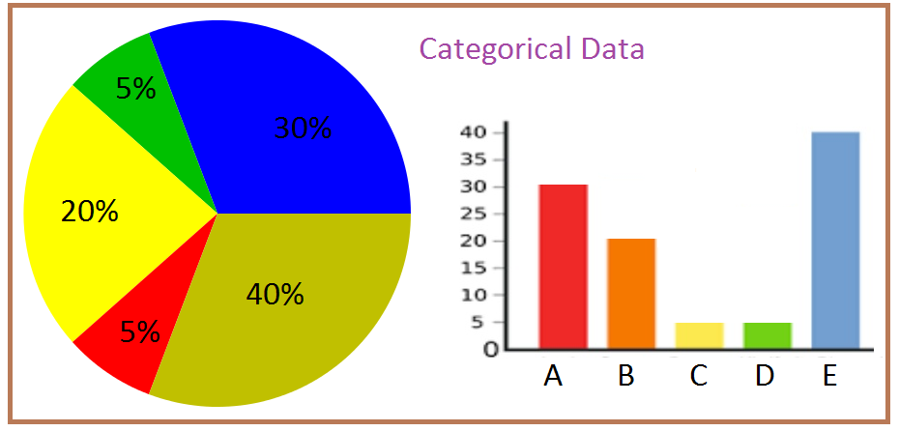
Data Description

Slide 8
Data Source
Dataset is collected from Kaggle website. Which is publically available. By using this website, you can access many more dataset for any kind of project.
https://www.kaggle.com/

Slide 9
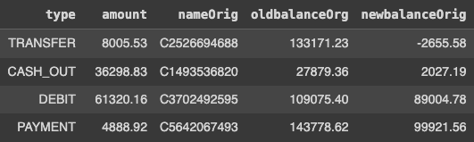
Key Features:
type: Type of transaction (e.g., PAYMENT, TRANSFER).
amount: The amount of money involved in the transaction.
oldbalanceOrg: Balance before the transaction.
newbalanceOrig: Balance after the transaction.
isFraud: Target variable indicating whether the transaction is fraudulent (1 for fraud, 0 for non-fraud).

Slide 10
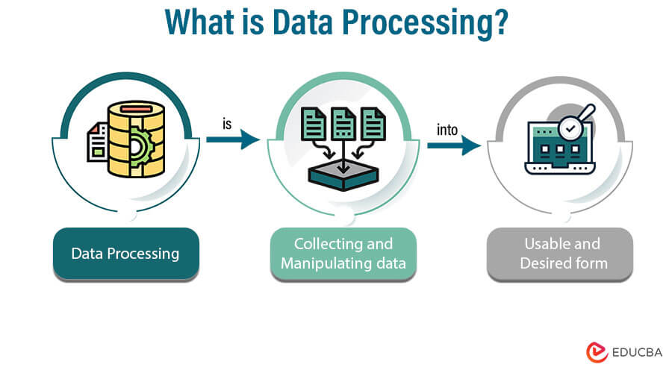
Data Processing
Handling Missing Data
Removed rows with missing values to ensure data quality.
Feature Selection
Selected key features (type, amount, oldbalanceOrg, newbalanceOrig) relevant for fraud detection.
One-Hot Encoding
Converted categorical variable type into numerical format using one-hot encoding.

Slide 11
data.dropna(inplace=True) data.isnull().sum()
x = data[['type', 'amount', 'oldbalanceOrg', 'newbalanceOrig']] y = data['isFraud']
CODE
Handling Missing Data
Feature Selection

Slide 12
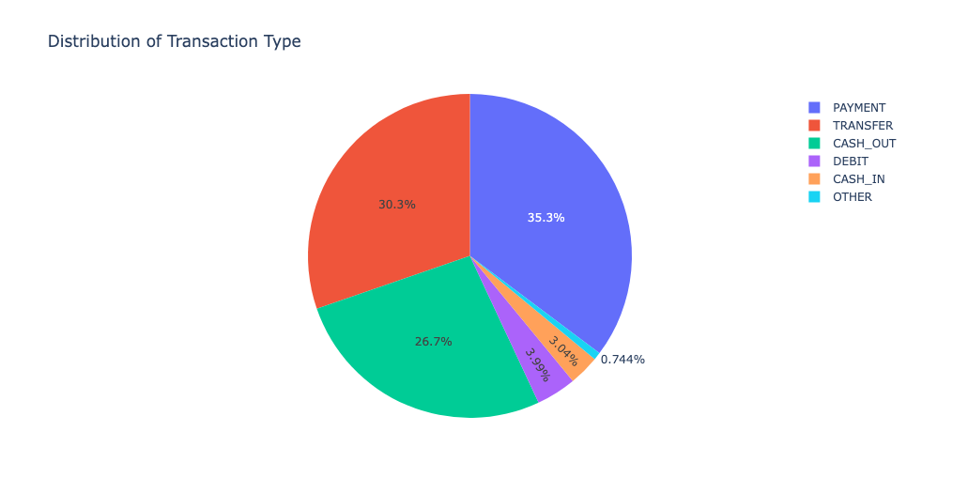
Dataset Statistics
The Dataset has the given types
TRANSFER
CASH_OUT
DEBIT
CASH_IN
PAYMENT
OTHERS
Distribution of Transaction Type

Slide 13
type=data['type'].value_counts() transactions=type.index quantity=type.values figure=px.pie(data, values=quantity, names=transactions, title='Distribution of Transaction Type') figure.show()
CODE:

Slide 14
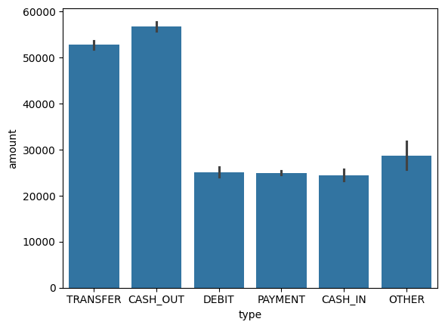
Barplot:
sns.barplot(x='type', y='amount', data=data)

Slide 15
Implementation
Collected transaction data and extracted key features.
Used Python and scikit-learn for model development.
Trained model can detect fraudulent transactions in real-time.

Slide 16
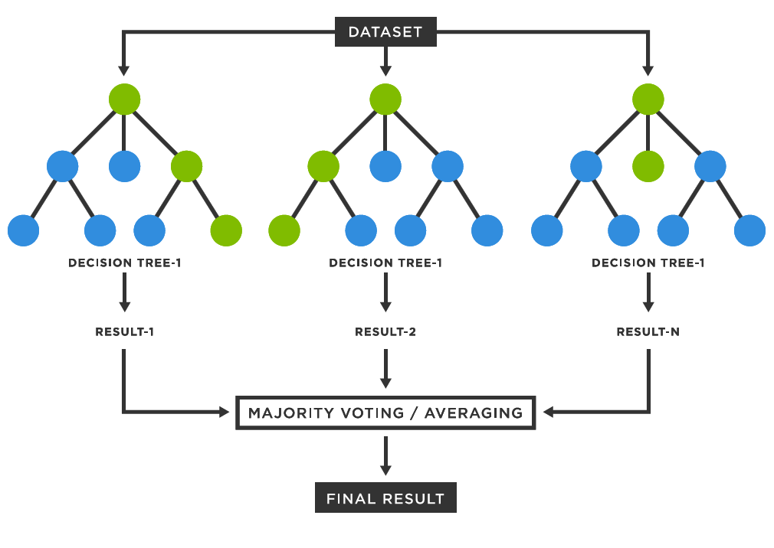
Modeling Approach:
Algorithm Selection:
We use Random Forest because it works well with big data.
It combines many decision trees to make better predictions.
It avoids mistakes by averaging results from all trees.

Slide 17
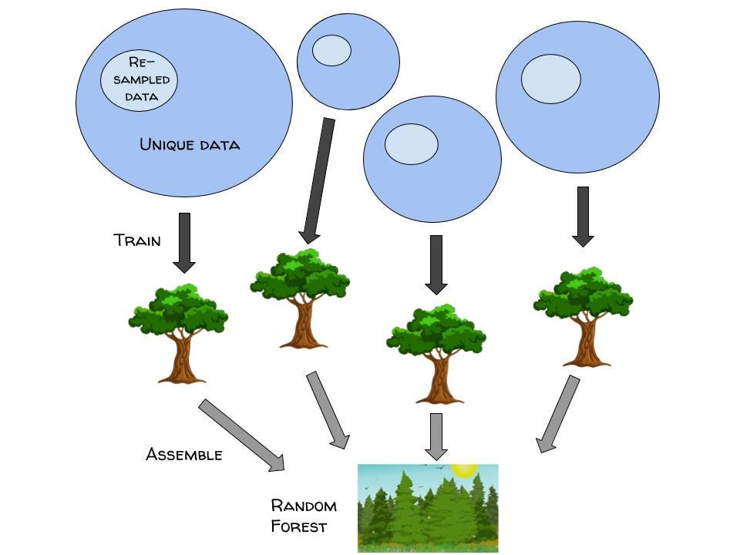
Model Training Process
Data Split: Divided data into training (80%) and testing (20%) sets to evaluate performance.
SMOTE Technique: Used SMOTE on the training set to address class imbalance before training.
Model Fitting: Trained the Random Forest model on the resampled training data.

Slide 18
CODE:
x_train, x_test, y_train, y_test = train_test_split(x, y, test_size=0.2, random_state=42)
from imblearn.over_sampling import SMOTE
model = RandomForestClassifier()
# Apply SMOTE to balance the classes
smote = SMOTE(random_state=42)
x_train_resampled, y_train_resampled = smote.fit_resample(x_train, y_train)
# Train the model on the resampled data
model.fit(x_train_resampled, y_train_resampled)

Slide 19
Model Evaluation:
Accuracy: Present the accuracy of your model on the test set (86.91%).
Confusion Matrix: Show a visual of the confusion matrix to illustrate true positives, true negatives, false positives, and false negatives.
Classification Report: Mention other key metrics like precision, recall, and F1-score, and explain what they mean.

Slide 20
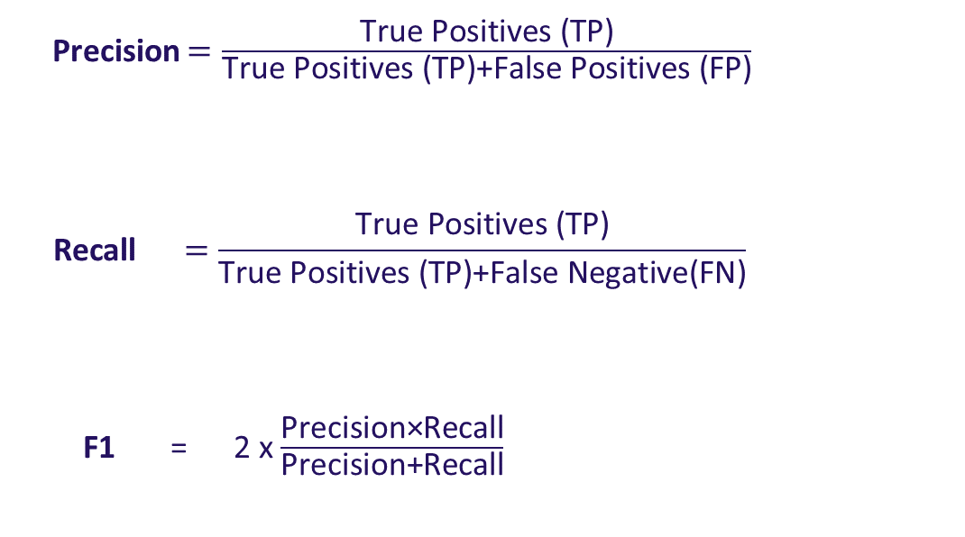
FORMULAS:
Precision $=\frac{\text{True} \text{Positives}\text{ (}\text{TP}\text{)}}{\text{True} \text{Positives}\text{ (}\text{TP}\text{)+}\text{False} \text{Positives}\text{ (}\text{FP}\text{)}}$
$$\text{Recall} =\frac{\text{True} \text{Positives}\text{ (}\text{TP}\text{)}}{\text{True} \text{Positives}\text{ (}\text{TP}\text{)+}\text{False} \text{Negative}\text{(}\text{FN}\text{)}}$$
F1 = 2 x $\frac{\text{Precision}\text{×}\text{Recall}}{\text{Precision}\text{+}\text{Recall}}$

Slide 21
CODE:
y_pred = model.predict(x_test)
# Evaluate the model
accuracy = accuracy_score(y_test, y_pred)
print(f'Accuracy: {accuracy * 100:.2f}%')
from sklearn.metrics import classification_report, confusion_matrix
# Make predictions on the test set
y_pred = model.predict(x_test)
# Print detailed classification report
print(classification_report(y_test, y_pred))

Slide 22
Confusion Matrix:
A table used to evaluate the performance of a classification model.
Displays the counts of actual vs. predicted classifications across all classes.
Key Components:
True Positives (TP)
True Negatives (TN)
False Positives (FP)
False Negatives (FN)

Slide 23
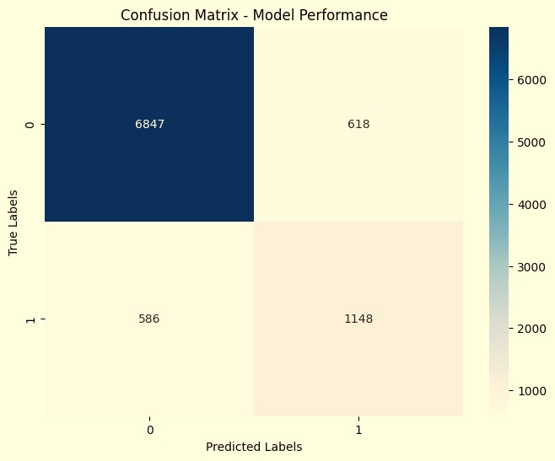
Visualization
Heatmap color intensity indicates the number of instances in each category (TP, TN, FP, FN).

Slide 24
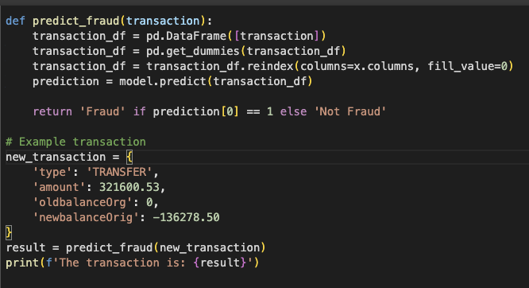
Fraud Prediction Example
Include a snippet of the predict fraud function, which takes a new transaction and predicts whether it’s fraudulent.
Show an example of how the function works with a sample transaction and display the prediction result.

Slide 25
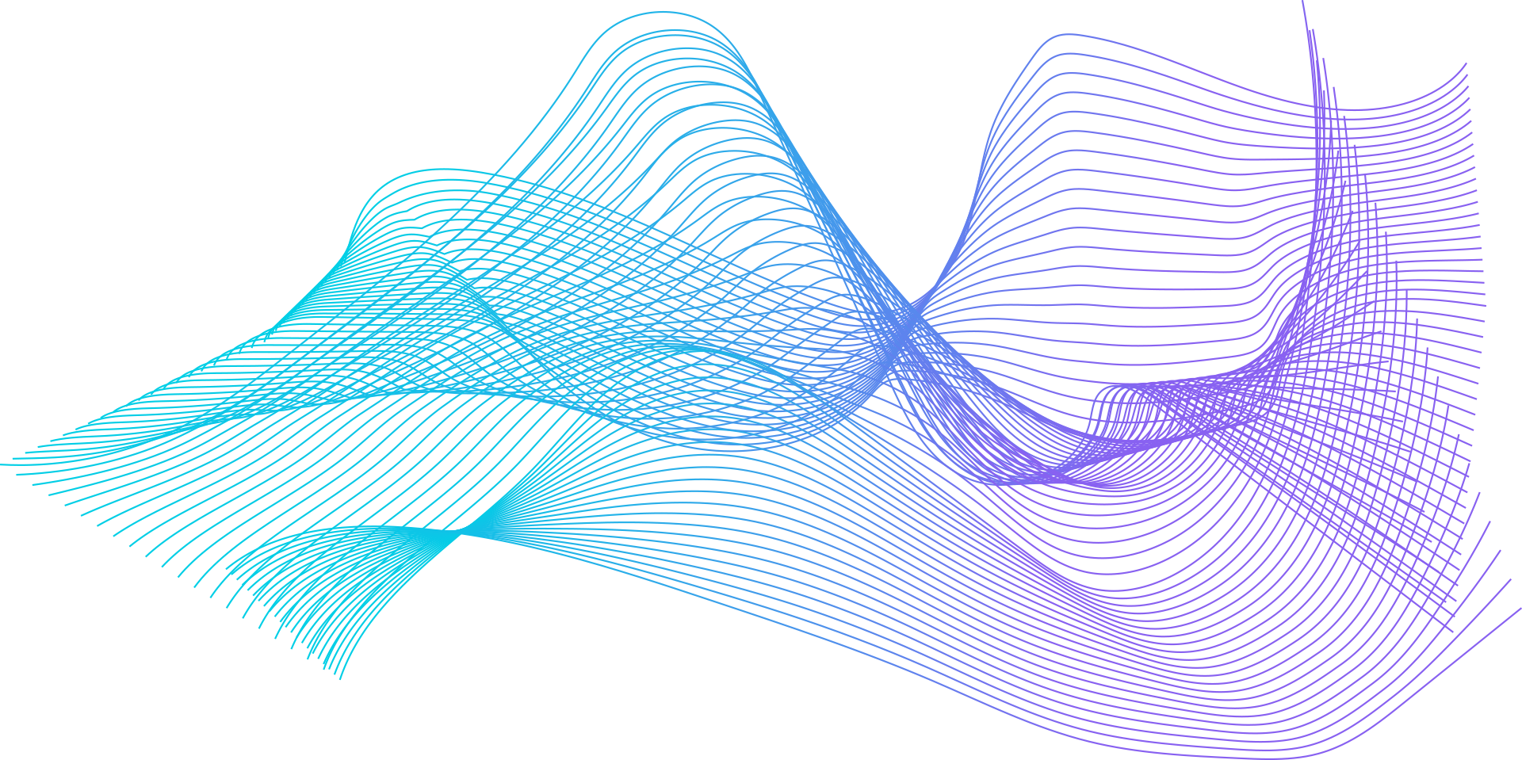


Conclusion:
Built a Random Forest model to detect online fraud successfully.
Used tools like confusion matrix and feature importance to check how well the model works.
Future improvements: try better models and add more features to detect fraud more accurately.

Slide 26
Thanks!

